Slide 1
Sentiment Trends in Walmart Services: A Data-Driven Approach
Presented by :
N SaiRam Gopal – 21BRS1459 Project guide :
D L K Trinadh – 21BAI1579 Mary Shamala O S Rishi Patri – 21BPS1396

Slide 2
Table of contents
01
02
03
04
Introduction
Literature Survey
Research Objectives
Methodology
05
06
Results
Key Findings
Proposed system
Problem statement
08
07
Future Goals
References

Slide 3
01
Introduction

Slide 4
Introduction
The very important sub-domain of NLP is sentiment analysis, which primarily tries to identify the tone along with the meaning of the written data.
While considering e-commerce, sentiment analysis is a pretty powerful tool through which one could calculate his customer's satisfaction towards the product/service, the service quality, etc.
With the rise of digital commerce, the volume of user-generated content has grown exponentially, making automated sentiment analysis indispensable for understanding customer perspectives and driving business decisions.

Slide 5
02
Literature Survey

Slide 6
Title | Author | Methodology | Limitations
Real-time Sentiment Analysis for E-commerce Applications | Jabbar et al. | SVM to predict sentiment at review and sentence levels using Amazon reviews. | Limited ability to capture linguistic nuances.
Temporal and Sentimental Dynamics of Indian E-commerce Reviews | Arora et al. | Text Blob and ANOVA; word clouds to study seasonal sentiment trends. | Basic NLP tools limit handling of complex language.
Aspect Sentiment Analysis via Triplet Extraction and BiLSTM | Sundaram et al. | BiLSTM with triplet extraction and VADER-based sentiment tagging. | Limited generalization due to handcrafted features and basic LSTM.

Slide 7
Aspect-Based Sentiment Analysis Using LDA | Wahyudi et al. | LDA with Collapsed Gibbs Sampling; evaluated sentiment across categories. | Probabilistic models lack linguistic nuance.
Sentiment Analysis of Bangla E-commerce Reviews | Zulfiker et al. | SVM (90.68%) on Bangla corpus using TF-IDF and trigram features. | Small dataset and manual annotation limit scalability.
Transfer Learning with Transformers for E-commerce Sentiment | Guru Prasad et al. | BERT and variants for aspect-based sentiment on Amazon/Flipkart data. | High resource requirements and domain adaptation challenges.
Efficient ML Techniques for E-commerce Sentiment | Bharti et al. | CNN, LSTM, RMDL with BERT, ELMo, FastText embeddings. | Effectiveness depends heavily on data quality and tuning.

Slide 8
Sentiment Framework for Zomato Reviews | Chaudari et al. | Bi-LSTM and Bi-GRU with Word2Vec and VADER. | Bi-LSTM showed overfitting; performance sensitive to hyperparameters.
Sentiment Analysis of Tokopedia Reviews | Hakkinen et al. | Lexicon-based approach and Naïve Bayes; focused on negation, intensifiers. | Contextual ambiguity and complex expressions not handled well.
Fashion E-commerce Sentiment Analysis | Kathuria et al. | Logistic Regression (88.18%), SVM, RF with VADER and TextBlob. | Challenges in subjectivity, data cleaning, and over-attribution of positivity.
Arabic Sentiment Classifier for Service Reviews | Al Omari et al. | Logistic Regression with TF-IDF on 3,916 Arabic reviews. | Poor recall for negative sentiment due to data imbalance and sarcasm.

Slide 9
Customer Sentiment Toward Bangladeshi Courier Services | Bitto et al. | Naïve Bayes (90.72%) with bigram features; 6 ML models evaluated. | Limited dataset, manual labeling, underperformance of SVM.
E-commerce Service Quality Sentiment Analysis | Sari et al. | Naïve Bayes + TF-IDF to analyze 5 e-Servqual dimensions. | Limited temporal data scope, no social media data.
Trust-Based Product Review Analysis Using STRUMKNN | Mugil et al. | STRUMKNN combining sentiment + trust weight, outperforming SVM & K-means. | Rule-based sentiment system struggles with sarcasm and nuance.

Slide 10
Enhancing Recommendation Systems via Sentiment Analysis | Panduro et al. | Logistic Regression, SVM, CNN, LSTM with TF-IDF/Word2Vec. | Difficulty handling fake/complex reviews; needs ethical, multimodal AI.
BERT-based Sentiment Model for Indian Fashion E-commerce | Taneja et al. | BERT model with dropout & FC layer on 7,500+ reviews. | Occasional misclassifications, especially for neutral sentiment.
Emotion Detection in French E-commerce | Mboungou et al. | RNN and LSTM with TF-IDF; aspect mapping (e.g., price, quality). | Sarcasm and ambiguity still require human intervention.
Bibliometric Analysis of E-commerce and Sentiment Research | Casas-Valadez et al. | VOSviewer & Scopus data (2007–2020); cluster mapping and trend analysis. | Lacks empirical sentiment model validation.

Slide 11
Hybrid Sentiment Model using BERT and RoBERTa | Jahnavi et al. | BERT + RoBERTa on Kaggle dataset with metadata; accuracy: 82%. | Limited generalization due to dataset scope.
COVID-19 Sentiment Analysis on Twitter | Samonte et al. | CNN + LSTM hybrid on preprocessed Twitter data. | Embeddings may not capture evolving language/slang.

Slide 12
Problem Statement
The growth of e-commerce platforms has led to an overwhelming volume of customer reviews and feedback, often expressed in diverse languages, informal styles, and varying emotional tones.
Manual analysis of such vast and unstructured data is both time-intensive and error-prone. Moreover, existing sentiment analysis systems often face challenges in detecting nuanced expressions like sarcasm, context-specific meanings, and domain-specific sentiments.
A strong sentiment analysis system is therefore needed to process, analyze, and classify customer feedback in an effective manner, addressing these challenges while ensuring scalability and accuracy.

Slide 13
03
Research Challenges

Slide 14
Research Objectives
1.Develop a scalable sentiment analysis model for e-commerce platforms that can analyze large-scale datasets.
2.It enhances the accuracy of sentiment classification by tackling challenges such as sarcasm, informal language, and domain-specific contexts.
3.Cater for various user bases through multilingual capability.
4.Provide actionable insights through the classification of overall and aspect-specific sentiments.
5.To build an explainable system that grants transparency in sentiment classification.

Slide 15
Research Challenges
Handling Unstructured and Noisy Data: Customer reviews are full of slang, abbreviations, emojis, and grammatical errors.
Sarcasm and Contextual Understanding: Sentiment reversal in reviews along with sarcasm make the job of accurate sentiment classification extremely difficult.
Scalability and Real-Time Analysis: The processing of large datasets or real-time feedback streams requires highly scalable systems.
Multilingual Support: E-commerce sites are multilingual, and therefore, they require a strong multilingual sentiment analysis system.
Aspect-Based Sentiment Analysis: Differentiating sentiments about specific aspects (e.g., product quality, delivery service) remains an ongoing challenge.

Slide 16
04
Methodology

Slide 17
Methodology
1.Data Gathering: Retrieve customer reviews, ratings, and feedback from websites like Amazon, Flipkart, eBay and services like Walmart etc .
2.Data Preprocessing: Cleaning includes the removal of noise, such as HTML tags, emojis, normalization, and tokenization.
3.Feature Engineering: More advanced techniques to be used, such as TF-IDF, Word2Vec, GloVe, and contextual embeddings coming from models like BERT and RoBERTa.

Slide 18
Methodology
4.Model Development: Development of machine learning algorithms, like SVM and Random Forest, and deep learning models like LSTM, GRU, or Transformer-based architectures.
5.Evaluation: Evaluate the performance by standard metrics such as precision, recall, F1-score, and accuracy and benchmark against baselines.
6.Visualization: Create dashboards for data visualization to present trends in sentiments and actionable insights.

Slide 19
Proposed System
1.Hybrid model-combining Transformer-based architectures like Transformer-based Models (BERT, XLNet, RoBERTa, T5, DistilBERT, ALBERT), with aspect-based sentiment classification techniques.
2.Multilingual sentiment analysis to cater for international customers.
3.Scalable architecture for the analysis of large data sets with real-time sentiment detection.
4.Integration of Explainable AI (XAI) for model decision insight to increase trust and transparency.
5.Visualization tools for summarizing insights and trends for business stakeholders.

Slide 20
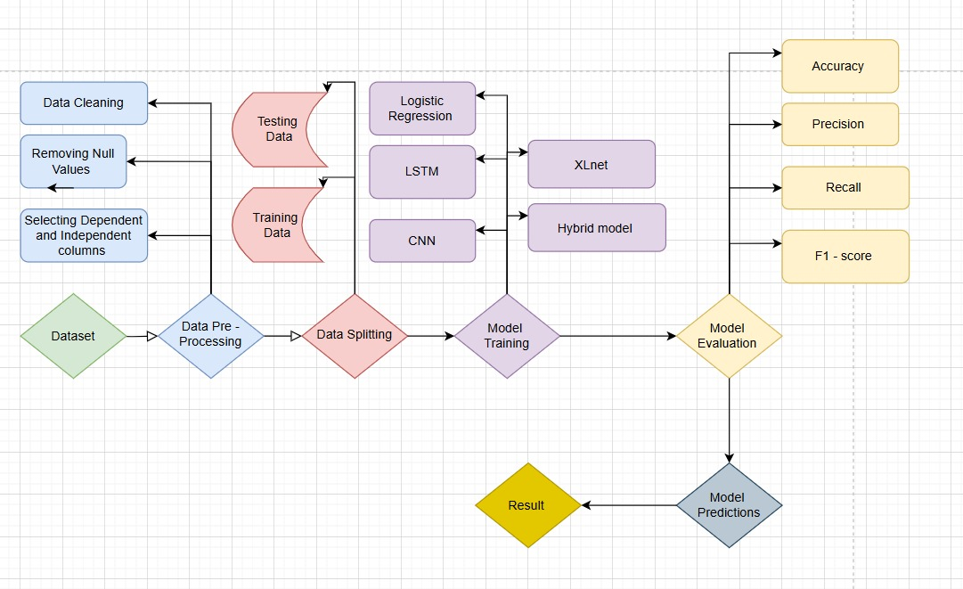
Architecture Diagram

Slide 21
05
Results

Slide 22
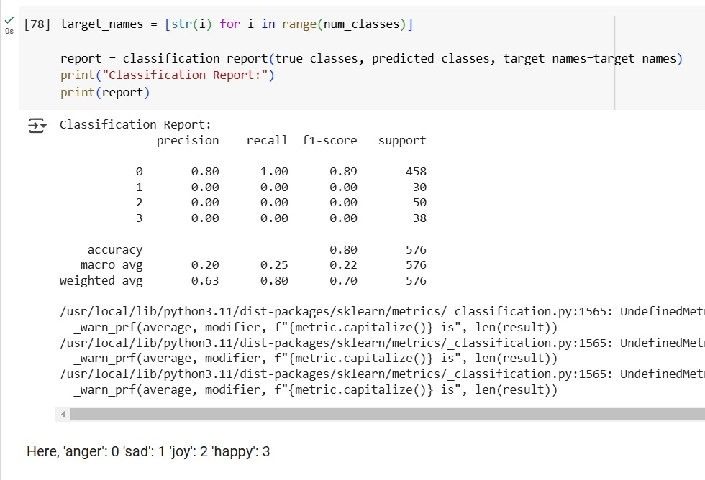
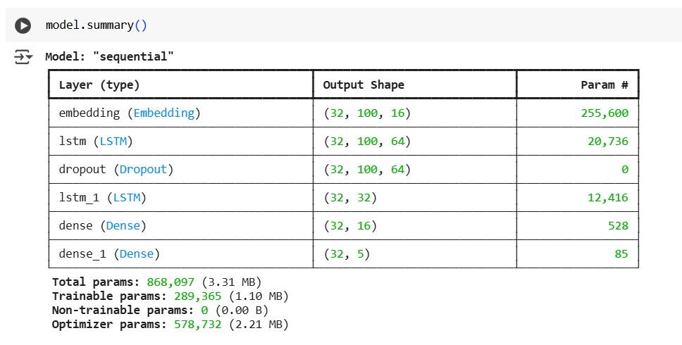
Implementation of LSTM model

Slide 23
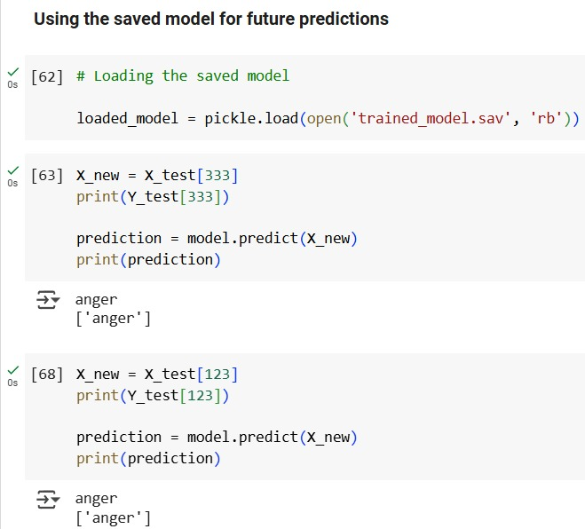
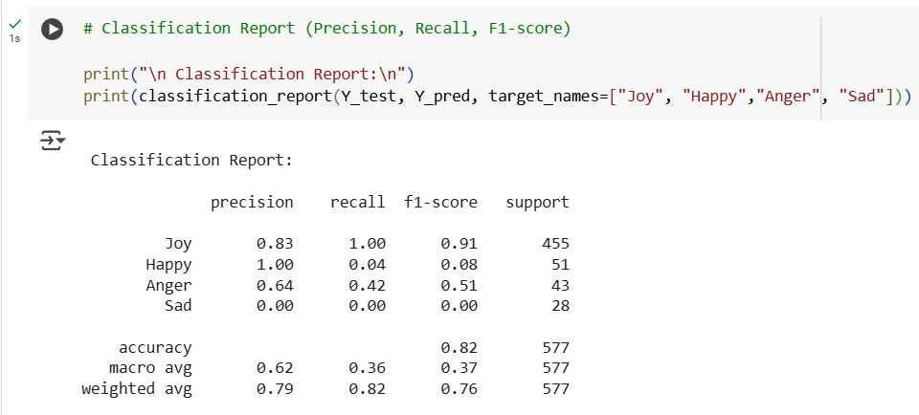
Implementation of Logistic regression

Slide 24
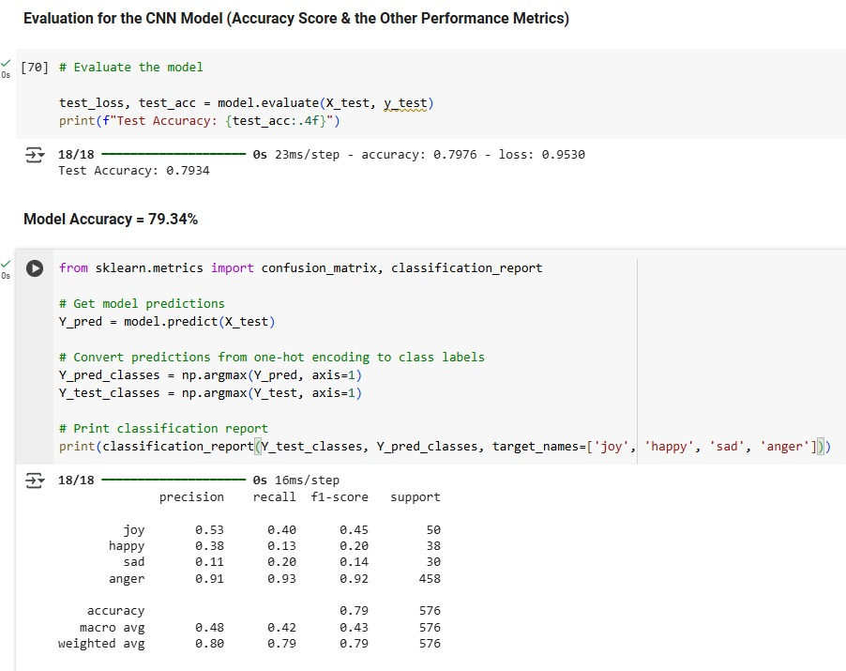
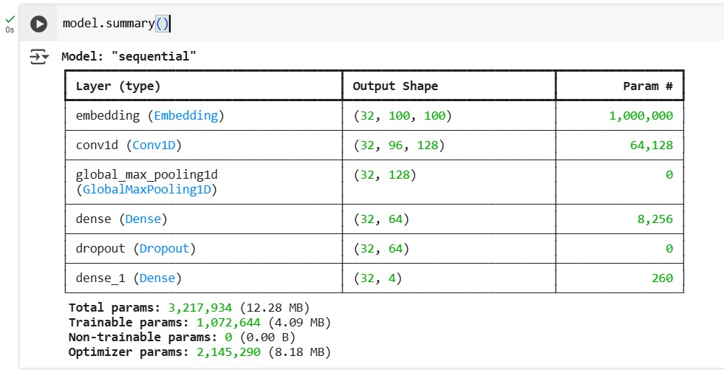
Implementation of CNN

Slide 25
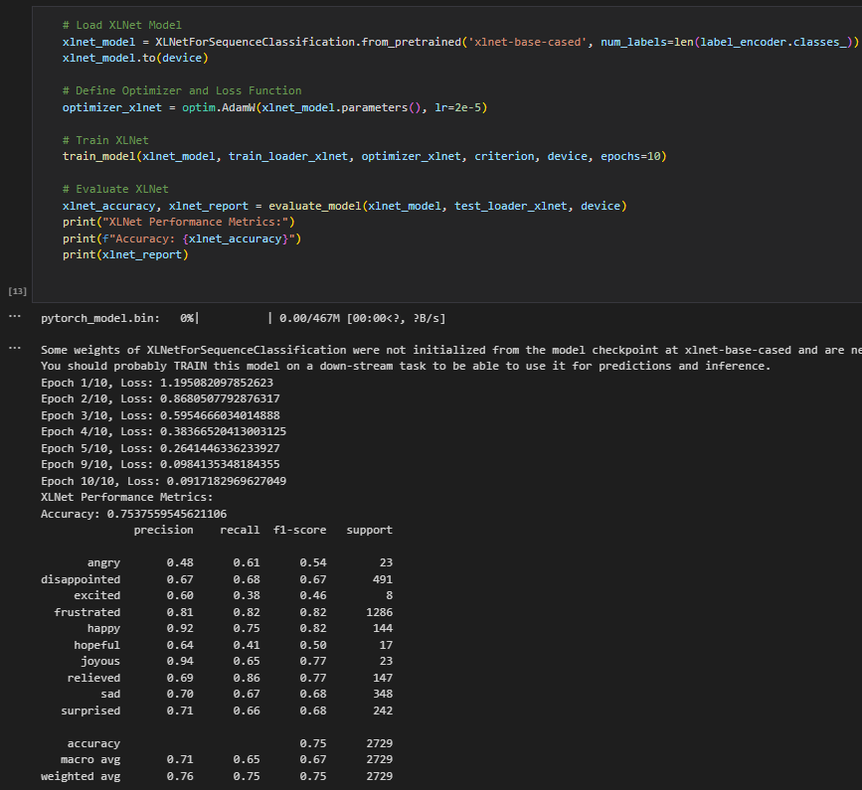
Implementation of XLNet

Slide 26
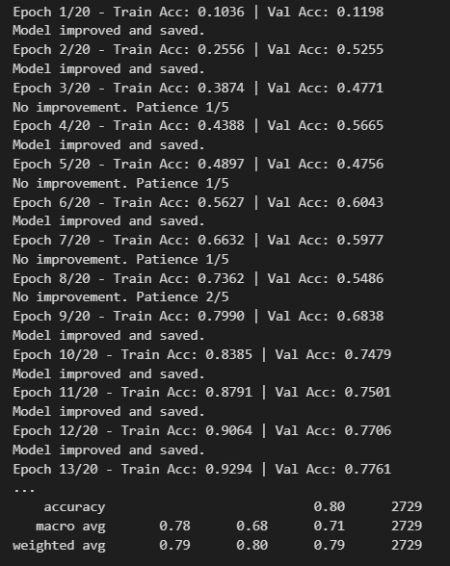
Implementation of Hybrid model

Slide 27
06
Key Findings

Slide 28
Performance Evaluation
Model | Accuracy | Precision | Recall | F1-Score
CNN | 79.9% | 91% | 93% | 92%
Logistic Regression | 80% | 83% | 91% | 91%
LSTM | 79% | 80% | 82% | 89%

Slide 29
Model | Accuracy | Precision | Recall | F1-score
XLNet | 75 | 76 | 75 | 75
Hybrid | 80 | 79 | 80 | 79

Slide 30
Evaluation of Models
CNN delivered the highest F1-score (92%) and recall, indicating its effectiveness in capturing both positive and negative sentiments accurately.
Logistic Regression performed consistently well with 91% F1-score, showing that even traditional ML models can compete with deep learning when features are engineered properly.
LSTM showed balanced performance but slightly lagged behind CNN and Logistic Regression.
Transformer-based models (XLNet) had relatively lower performance, potentially due to:
Lack of domain-specific fine-tuning
Model overfitting or underfitting due to training data volume

Slide 31
Hybrid Model (BERTa + Bilstm+ Attention) outperformed individual transformers, confirming that ensemble strategies can enhance overall classification.
Precision vs Recall Trade-off: CNN showed very high recall, making it suitable when false negatives are more costly (e.g., missing negative reviews).

Slide 32
07
Future Goals

Slide 33
Future Goals
1.Extend the system to multimodal sentiment analysis, supporting both audio and visual inputs.
2.Develop robust systems that can detect the complex nuances like sarcasm, double negatives, etc.
3.Expand multilingual support to cover low-resource languages.
4.Integrate the system with recommendation engines for better personalization.
5.Create an entirely autonomous system that is able to generate action-forwarding insights without human input.

Slide 34
08
References

Slide 35
Research references
Jabbar et al. [1] present research on real-time sentiment analysis for e-commerce applications, focusing on product reviews from Amazon.com. The study designs and implements a model using a SVM, a machine learning technique, to predict sentiment polarity at both review and sentence levels.
Arora et al. [2] explore the temporal and sentimental dynamics of customer reviews from an Indian e-commerce platform between 2019 and 2023. The study employs NLP techniques with TextBlob and statistical tools like ANOVA to analyze evolving emotions across time. Word cloud visualizations and sentiment classification highlight seasonal variations and feature-specific feedback. While the approach effectively uncovers sentiment trends, its reliance on basic NLP tools may limit accuracy in handling complex linguistic nuances, suggesting the need for more advanced language models in future work.
Sundaram et al. [3] propose an aspect sentiment analysis system for e-commerce using triplet extraction and a BiLSTM-based model. The approach identifies opinion-aspect-sentiment triplets from customer reviews and leverages VADER and syntactic rules for sentiment classification. With an AUC of 0.9 and an average precision of 0.89, the system shows strong performance, including sarcasm detection. However, the reliance on handcrafted preprocessing and basic LSTM layers may limit generalization, highlighting potential for further enhancement through more robust attention-based or generative models.

Slide 36
Wahyudi et al. [4] explore aspect-based sentiment analysis in e-commerce reviews using Latent Dirichlet Allocation (LDA) with Collapsed Gibbs Sampling. The study evaluates sentiment classification accuracy across product categories, comparing general versus category-specific training data. The best performance, with 67.5% accuracy, was achieved using LDA with α=0.001, β=0.001, and 15 topics. Combining general and category-based data slightly improved accuracy by 0.82%. However, the reliance on probabilistic modeling limits linguistic nuance capture, suggesting potential gains through integration with deep learning techniques.
Zulfiker et al.[5] present a machine learning approach for Bangla sentiment analysis on e-commerce reviews. The study constructs a labelled Bangla corpus and evaluates six classifiers using TF-IDF with trigram features. Among them, a hyperparameter-tuned SVM model achieves the highest accuracy of 90.68%. The approach demonstrates strong performance across all metrics. However, the limited dataset size (1,631 reviews) and manual labelling may affect scalability and domain adaptability, suggesting the need for larger, more diverse corpora and automated annotation methods in future work.
Guru Prasad et al. [6] investigate sentiment analysis on e-commerce platforms using transfer learning with transformer-based models. The study applies BERT and its variants for aspect-based sentiment classification, using data from Amazon and Flipkart. The approach demonstrates strong contextual understanding and scalability across different models. However, the large model sizes, computational demands, and challenges in domain adaptation and nuanced aspect detection underscore the trade-offs between performance and efficiency, suggesting the need for careful model selection based on task complexity and resource constraints.

Slide 37
Bharti et al. [7] review efficient machine learning techniques for sentiment analysis of e-commerce customer reviews. The study explores models such as CNN, LSTM, and RMDL, alongside embedding methods like BERT, ELMo, and FastText, to categorize reviews into sentiment classes. It emphasizes the importance of preprocessing and contextual understanding. While the models show promising performance, their effectiveness heavily depends on data quality, feature extraction, and model tuning, suggesting the need for robust hybrid frameworks and domain-specific enhancements.
Chaudari et al. [8] present a sentiment analysis framework for Zomato restaurant reviews using Bi-LSTM and Bi-GRU models. The study combines Word2Vec embeddings with VADER and Sentiment Intensity Analyzer to enhance performance. Experimental results show Bi-GRU outperforms Bi-LSTM in generalization and accuracy, achieving 99.51%. While effective, the Bi-LSTM model showed signs of overfitting, and results varied with dropout rates and batch sizes, highlighting the importance of careful hyperparameter tuning and model selection.
Hakkinen et al. [9] perform sentiment analysis on Tokopedia e-commerce reviews using a lexicon-based method and Naïve Bayes classifier. The study focuses on handling negation, intensifiers, and complex expressions to improve sentiment scoring. With a 400-review dataset, results show 57.5% positive, 22.5% negative, and 20% neutral responses. While the approach is efficient for quick sentiment detection, it may struggle with contextual ambiguity and nuanced expressions, suggesting the need for hybrid or semi-supervised models for better accuracy.

Slide 38
Kathuria et al. [10] analyze sentiment in fashion e-commerce using ML and NLP techniques to study consumer behavior. They apply models like logistic regression, SVM, random forest, and sentiment tools like VADER and TextBlob on reviews and ratings. Logistic regression achieved the highest accuracy (88.18%) for reviews and 80.68% for ratings. While effective, the study highlights challenges in data cleaning, subjectivity handling, and over-attribution of positivity in lexicon-based models, suggesting potential improvements through advanced contextual models.
Al Omari et al. [11] propose a logistic regression-based sentiment classifier for Arabic service reviews in Lebanon. Using TF-IDF features on 3,916 manually collected reviews from Google and Zomato, the model performed well on positive reviews but struggled with negative ones due to data imbalance. Precision for negative sentiment was 0.80, but recall dropped to 0.08, resulting in an ROC AUC of just 0.54. The study highlights challenges in Arabic NLP, particularly sarcasm, code-mixing, and linguistic ambiguity, indicating the need for more balanced datasets and advanced modeling.
Bitto et al. [12] analyze customer sentiment toward Bangladeshi courier services using Bangla NLP and machine learning models. Reviews were scraped from social media for Sundarban, Redx, and Pathao, then classified using six algorithms and N-gram features. Multinomial Naive Bayes with Bigram features achieved the highest accuracy of 90.72%. The study effectively highlights sentiment trends, but limited data size, manual labelling, and underperformance of models like SVM suggest future work with deep learning and larger datasets for enhanced robustness.

Slide 39
Sari et al. [13] apply sentiment analysis to evaluate e-commerce service quality using user reviews from Tokopedia. The study classifies sentiments across five e-Servqual dimensions—reliability, responsiveness, trust, web design, and personalization—using a Naïve Bayes classifier with TF-IDF features. Results show an overall 90% accuracy, with trust and web design receiving the highest positive sentiment. However, personalization was dominated by negative feedback, indicating a need for improved customer engagement. While efficient, the approach is limited by temporal data scope and absence of social media inputs.
Mugil et al. [14] explore a trust-based product analysis model for e-commerce platforms using a hybrid STRUMKNN approach. The model combines sentiment analysis and word separation techniques to assess product reviews and generate trust profiles. By evaluating feedback through polarity-based classification, the system provides product suggestions based on review authenticity and trust weight. Comparative analysis with SVM and K-Means clustering shows that STRUMKNN achieves higher accuracy (92%) in sentiment classification and trust evaluation. While the model demonstrates strong performance, its rule-based sentiment mechanism may limit adaptability to nuanced or sarcastic language, indicating the potential benefit of integrating deep learning-based NLP models in future enhancements.

Slide 40
Panduro et al. [15] investigate the role of sentiment analysis in enhancing product recommendation systems within e-commerce platforms. The study applies various machine learning techniques—such as logistic regression, support vector machines (SVM), and deep learning models like CNN and LSTM—to classify customer review sentiments as positive, negative, or neutral. The methodology includes text preprocessing, feature extraction (e.g., TF-IDF, Word2Vec), and model evaluation using metrics like precision, recall, and F1-score. Experimental results show accuracy levels ranging from 80–90%, with logistic regression performing best. While the approach effectively personalizes recommendations based on user sentiment, challenges remain in handling fake reviews and complex linguistic patterns, suggesting the need for advanced multimodal and ethical AI models in future research.

Slide 41
Taneja et al. [16] explore customer sentiment in Indian fashion e-commerce using a BERT-based deep learning model. Focusing on reviews from platforms like Myntra, Ajio, and Tata Cliq, the study employs BERT's bidirectional contextual embeddings to classify sentiments into positive, neutral, or negative categories. The dataset, comprising over 7,500 reviews, is preprocessed and normalized before classification. The model architecture includes a dropout layer and a fully connected layer atop BERT to predict sentiment classes, achieving an accuracy of 92%, outperforming DistilBERT. While the approach effectively captures nuanced expressions in reviews, occasional misclassifications, especially in neutral cases, highlight challenges posed by subjective human language. Future work aims to incorporate multilingual analysis to cater to India’s diverse linguistic landscape, further improving sentiment classification in regional e-commerce contexts.
Mboungou et al. [17] examine sentiment patterns in customer feedback on a French e-commerce platform, leveraging a dataset of 56,000+ reviews across 16 product categories. The study utilizes advanced machine learning techniques, notably Recurrent Neural Networks (RNNs) and Long Short-Term Memory (LSTM) models, for emotion classification. Preprocessing includes stop-word removal, lemmatization, and feature extraction using TF-IDF. The system maps sentiments to aspects such as price, quality, shipment, design, and satisfaction. While LSTM aids in capturing long-term dependencies and subtle nuances in French-language reviews, challenges such as sarcasm and ambiguity still require human oversight. Overall, the approach enhances sentiment accuracy and offers actionable insights for businesses aiming to refine product offerings and customer engagement strategies.

Slide 42
Casas-Valadez, et al. [18] conduct a comprehensive bibliometric analysis to investigate the synergy between e-commerce and sentiment analysis in published research from 2007 to 2020. The study utilizes data from Scopus and applies performance metrics and co-occurrence mapping using tools like VOSviewer. It identifies three dominant research clusters: Data Collection & Analysis, Business Intelligence, and Lexicon-based Methods. These themes highlight the evolution of sentiment analysis from basic opinion mining to advanced AI-driven insights.
Jahnavi et al. [19] propose a hybrid sentiment analysis model for social media platforms by combining BERT and RoBERTa architectures. The study utilizes a Kaggle-based labeled dataset enriched with temporal and demographic metadata. Extensive preprocessing, exploratory data analysis, and word cloud visualizations are conducted to uncover textual characteristics. Evaluation with metrics such as accuracy, precision, recall, and F1-score demonstrate the model’s superiority over traditional methods like SVM, CNN, and standalone BERT, achieving 82% accuracy.
Samonte et al. [20] explore public sentiment during the COVID-19 pandemic by implementing a hybrid deep learning model that combines Convolutional Neural Networks (CNN) and Long Short-Term Memory (LSTM) networks to analyze Twitter data. The study focuses on capturing spatial features with CNN and temporal dependencies with LSTM to enhance sentiment classification. Tweets were preprocessed through tokenization, stopword removal, and lemmatization, followed by word cloud visualizations and class distribution analysis. The hybrid model outperformed traditional machine learning algorithms in accuracy and contextual understanding. However, its reliance on pre-COVID datasets and general-purpose embeddings may restrict adaptability to evolving slang and domain-specific expressions, indicating the need for dynamic and fine-tuned embedding techniques in future work.

Slide 43
Conclusion
In this project, six different machine learning and deep learning models—CNN, Logistic Regression, LSTM, XLNet, and a Hybrid Transformer model—were implemented and evaluated for sentiment analysis. Among these, CNN and Logistic Regression demonstrated superior performance in terms of F1-score and recall, indicating their effectiveness in correctly identifying both positive and negative sentiments.
While transformer-based models like XLNet did not outperform traditional models in this setup, the Hybrid model showed promise by combining their strengths and achieving competitive accuracy.
Overall, the results highlight the importance of model selection based on data size, task complexity, and performance trade-offs. Traditional models still hold strong when well-engineered, while deep learning and transformers can excel with further tuning and larger, more diverse datasets.

Slide 44
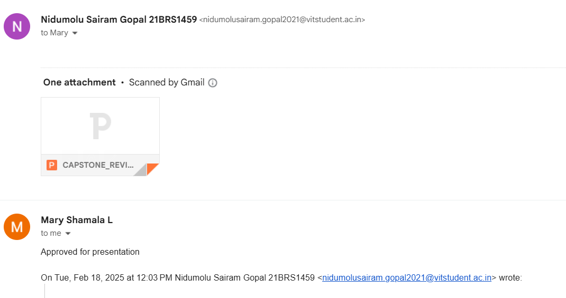
Guide Approval

Slide 45
THANK TOU

